Slide 1
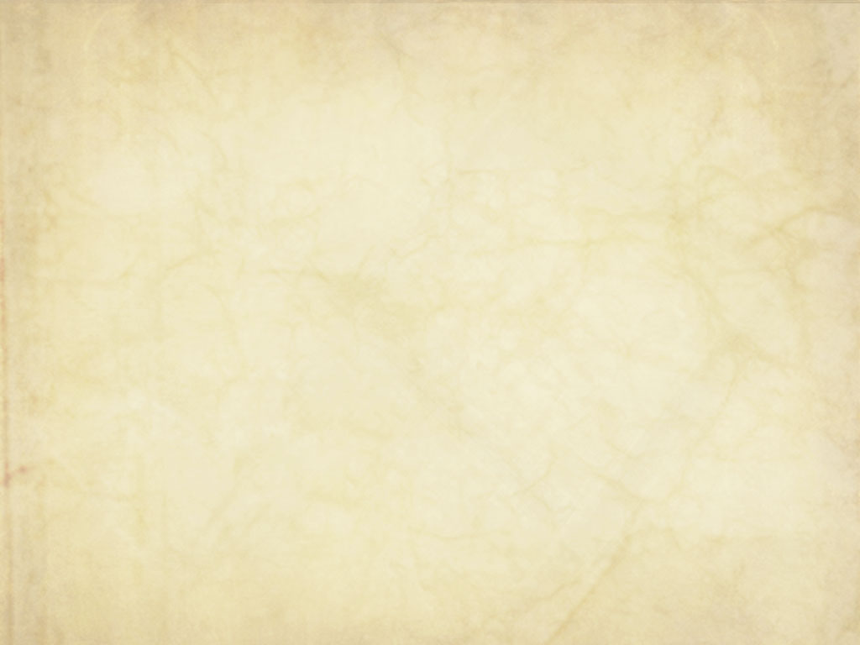
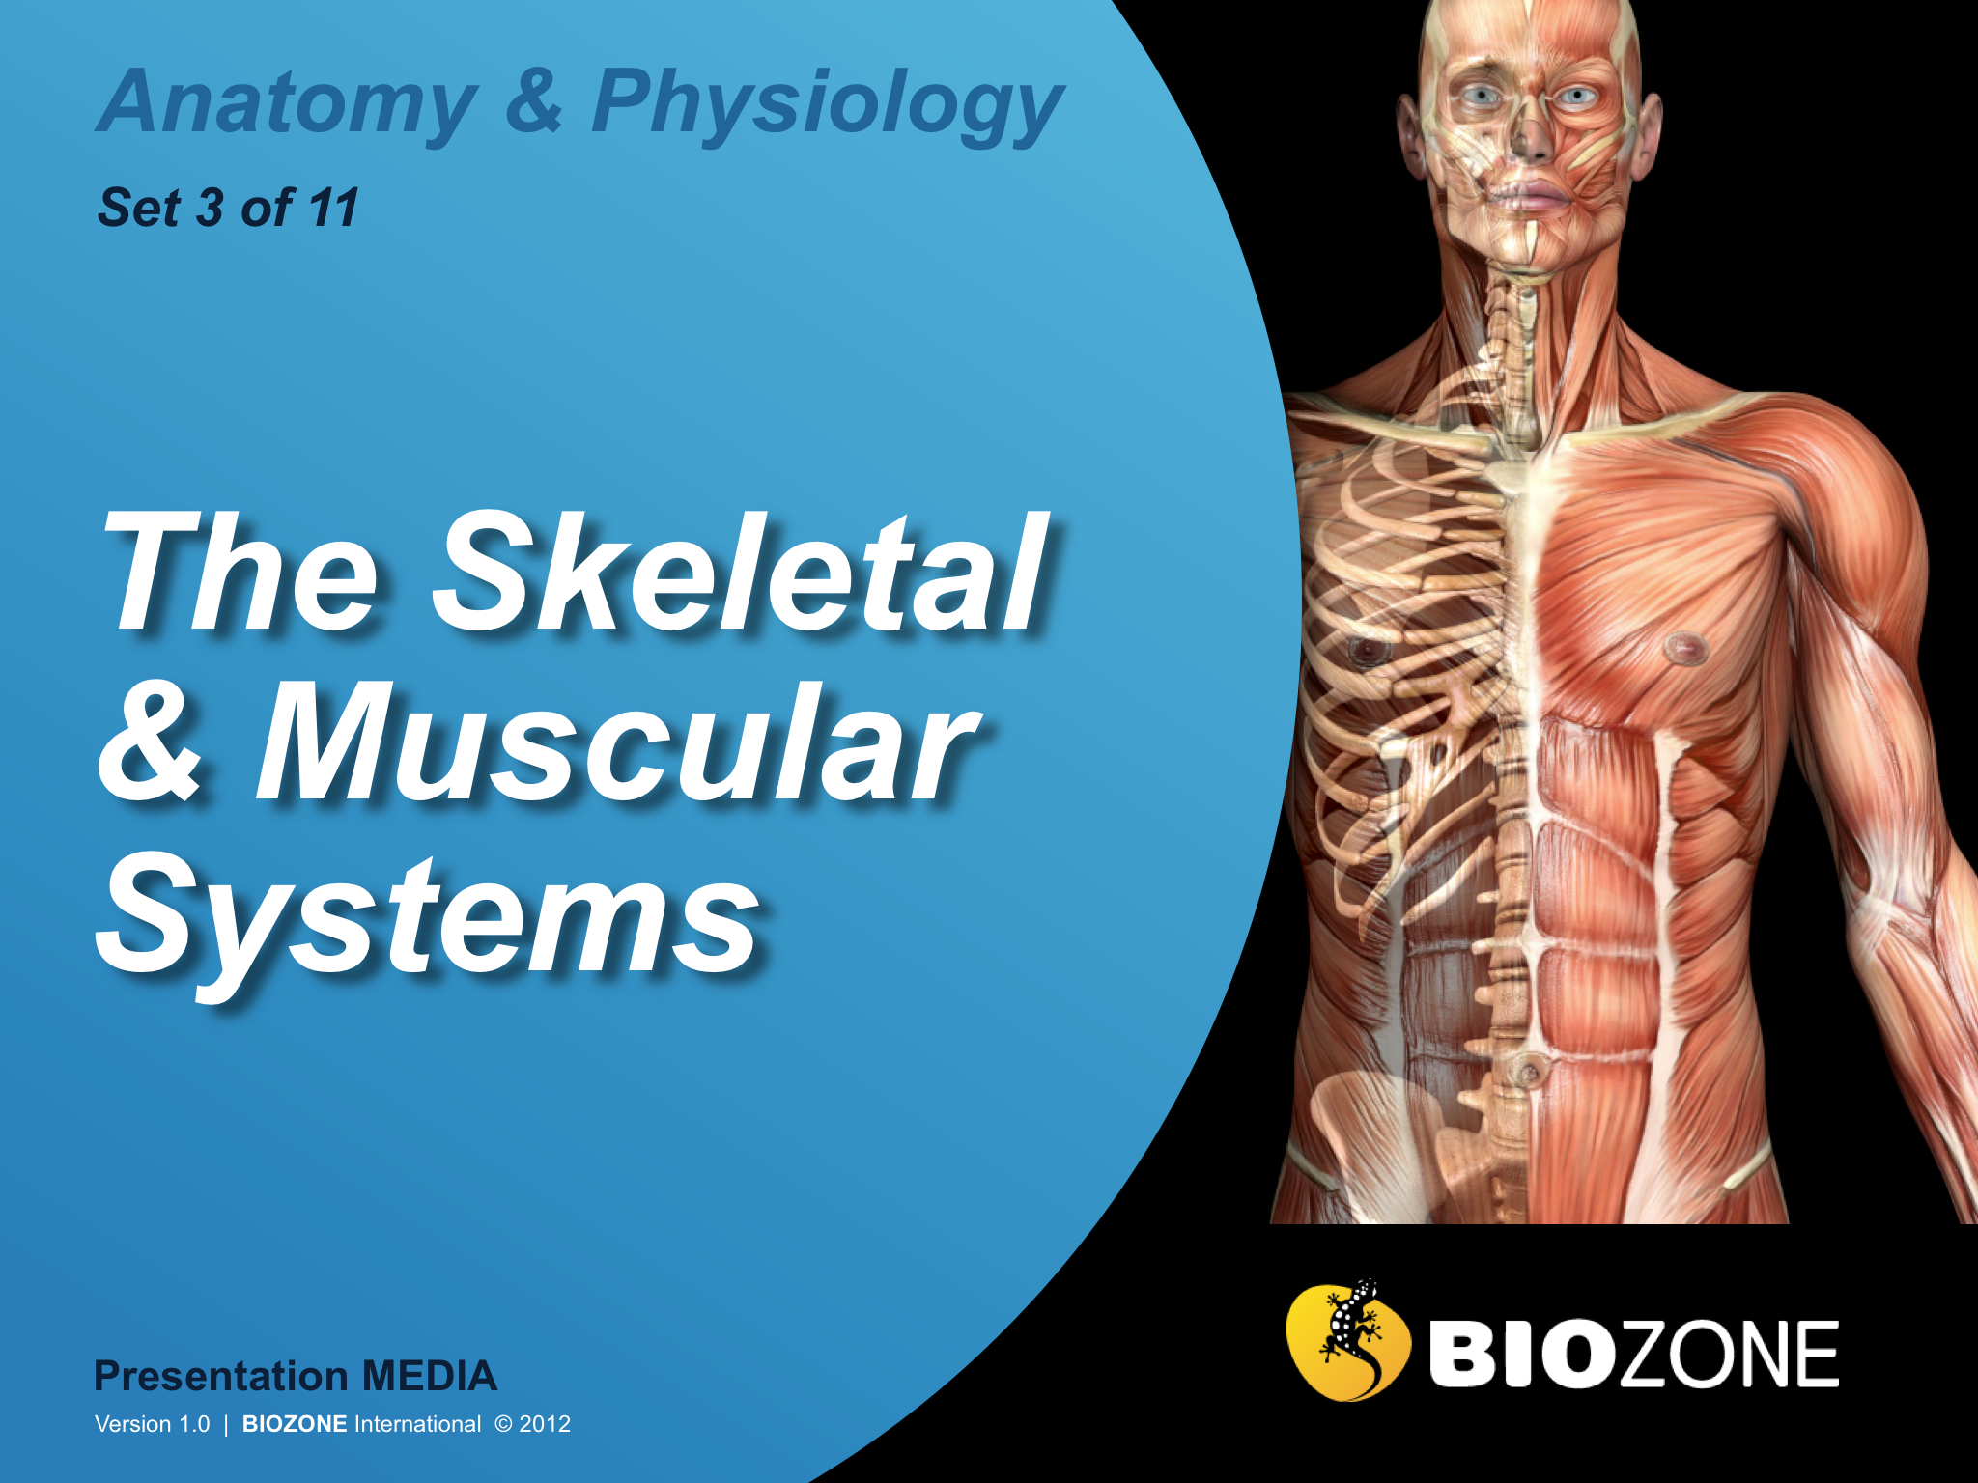

Slide 2
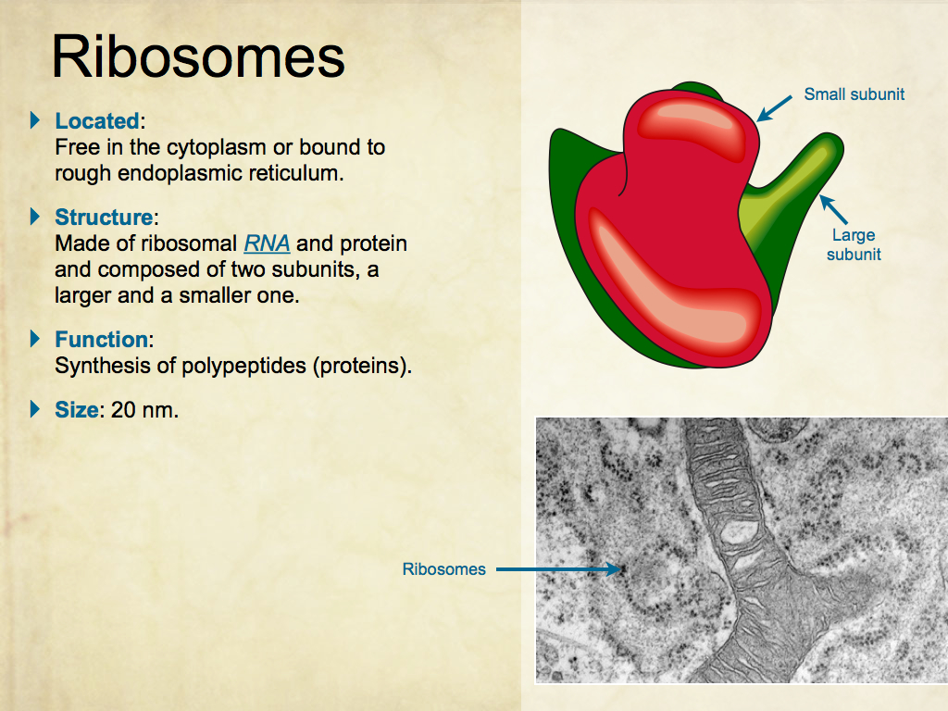
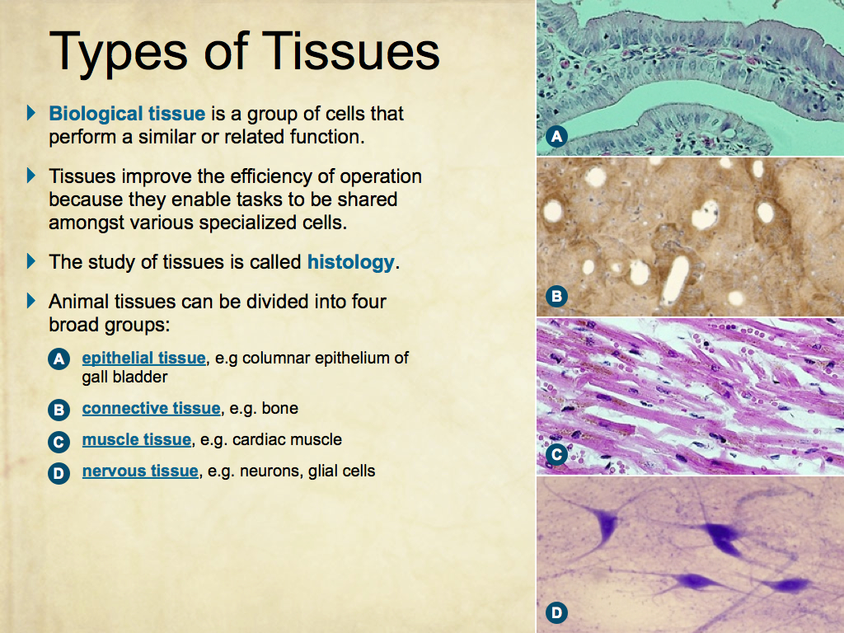
Using Presentation Media
BIOZONE Presentation Media
can be used either as a simple slide show or as an interactive lesson.
  Hyperlinks within the text take you to related slides.
Italicized hyperlinks link to the glossary of definitions.
Bold hyperlinks give direct access to specific slides.

Slide 3
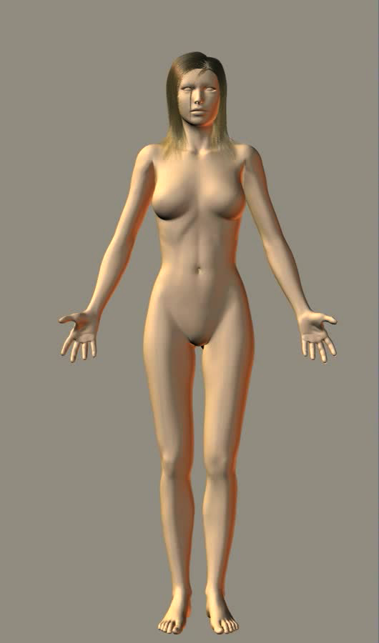
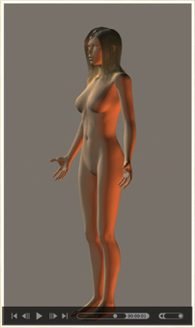
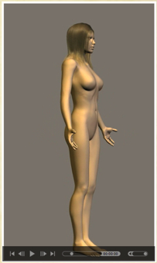
Using Presentation Media
BIOZONE Presentation Media can be used either as a simple slide show or as an interactive lesson
  The movie player allows you to rotate objects.
The movie loops continuously when activated
Use the movie controls in Keynote or Powerpoint
Pause the movie, then drag the slider to rotate the object back and forth

Slide 4
Introduction
  Interacting systems
  Contexts
The Human Skeleton
  The human skeleton
  The skull
  The spine
Bones
  Bones
  Bone structure
  Bone growth
Joints
  Synovial joints
  Fibrous joints
  Cartilaginous joints
  Movement of joints
Muscles
  Muscle cells
  Skeletal muscle structure
  Muscle movement
  Muscles of the body
  Contractions and movement
Muscles and Energy
  Energy for contractions
  VO2
  Posture
  Fatigue and training
Glossary

Slide 5
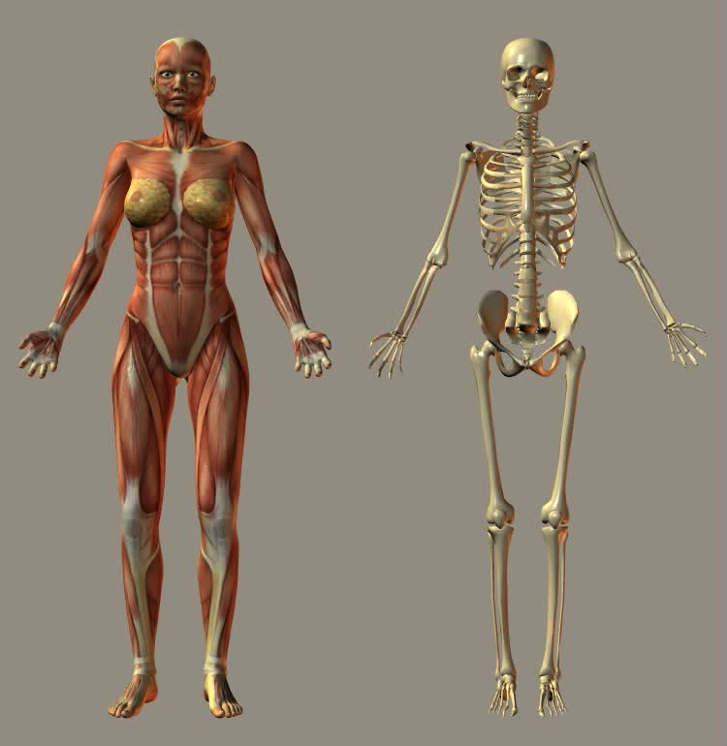
The Skeletal and Muscular System
The muscular and skeletal systems are separate systems but work closely together as the musculoskeletal system.
The muscular system provides the means for movement by contracting muscle fibers attached to either side of a joint.
The skeletal system provides the points of attachment for the muscles and enables movement by acting as a system of levers.

Slide 6
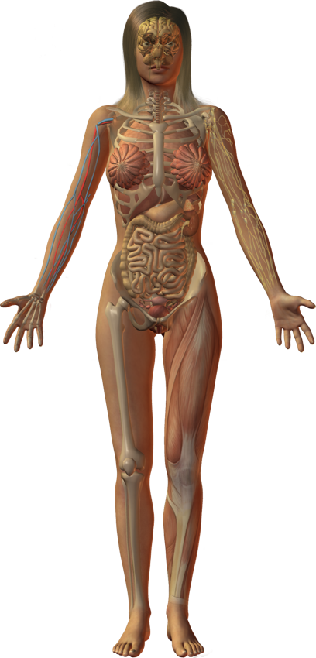
Interacting Systems
Nervous system
Endocrine system
Cardiovascular system
Respiratory system
Lymphatic system and immunity
The musculoskeletal system provides the framework to contain and support the body’s many other organ systems.
It provides the support, protection, and movement required by the body in its daily functions.
Urinary system
Reproductive system
Digestive system
Integumentary system
Muscular system
Skeletal system

Slide 7
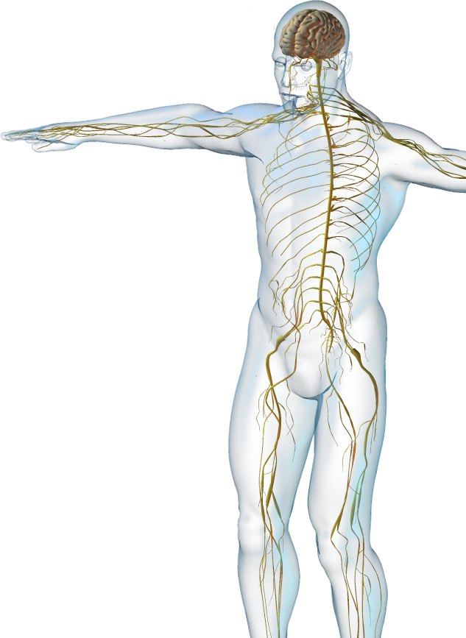
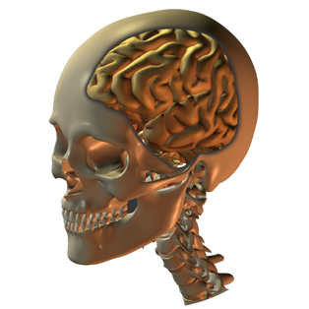
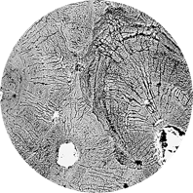
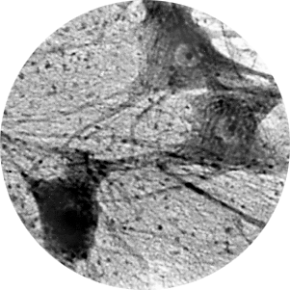
Nervous System
The skeletal and muscular systems interact with the nervous system.
  The skeleton protects the central
  nervous system.
  Bones act as a store of calcium ions required for nervous function.
  Innervation of bone and joint capsules provides sensation and positional awareness.
  Muscular activity is dependent
  on innervation.
EII

Slide 8
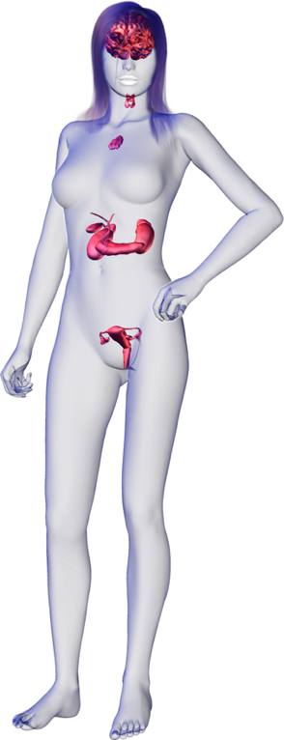
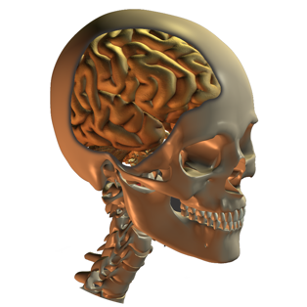
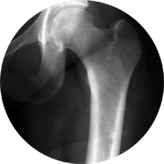
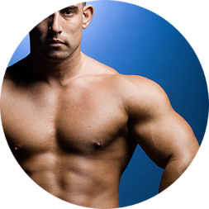
Endocrine System
The skeletal and muscular systems interact with the endocrine system.
  The skeleton protects the endocrine organs especially those in the pelvis, chest, and brain.
  Bone takes up and releases calcium in response to hormones.
  Androgens and growth hormone promote muscular strength and increase in muscle mass.
PC
CA

Slide 9
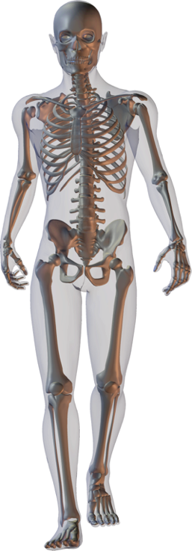
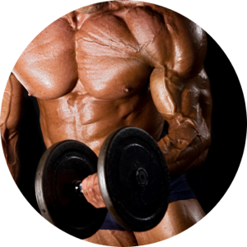
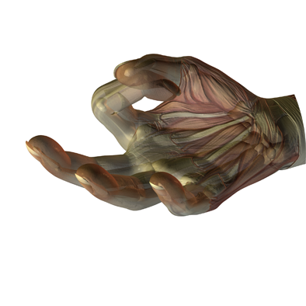
Skeletal System
The muscular system interacts with the skeletal system.
  Muscular activity maintains bone strength and helps determine bone shape.
  Muscles pull on bones to create movement.
Istock

Slide 10
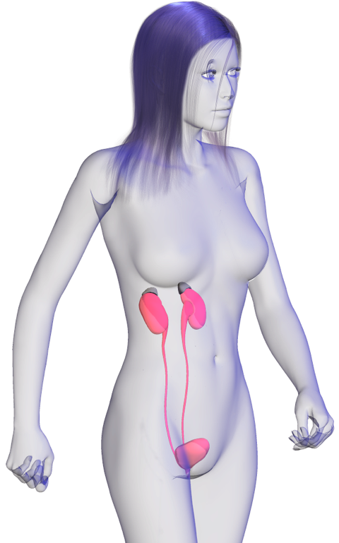
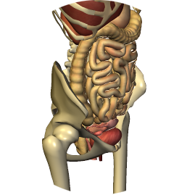
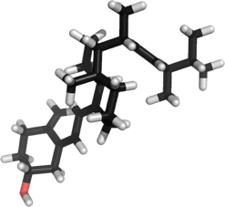
Urinary System
The skeletal and muscular systems interact with the urinary system.
  The skeletal system protects the
  pelvic organs.
  Final activation of vitamin D, which is involved in calcium and phosphorus metabolism, occurs in the kidneys.
  Urination (from about age 2) is controlled by a voluntary sphincter in the urethra.
Vitamin D

Slide 11
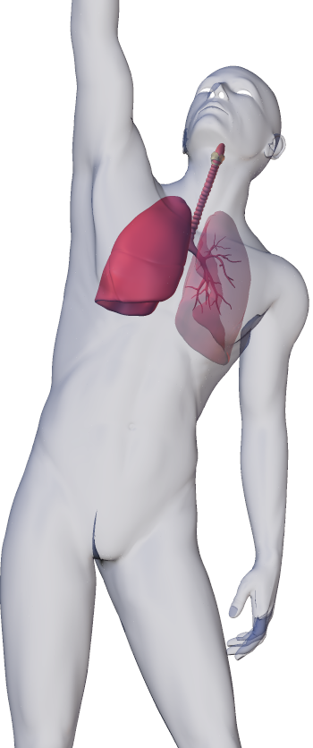

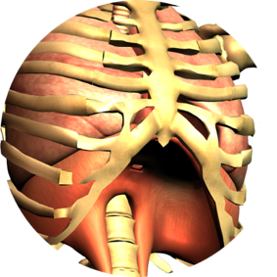
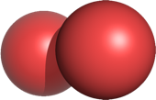
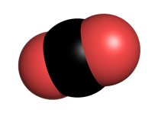
Respiratory System
The skeletal and muscular and systems interact with the respiratory system.
  Skeleton encloses and protects the lungs.
  Flexible ribcage enables ventilation of the lungs for exchange of gases (O2/CO2).
  Diaphragm and intercostal muscles produce volume changes in breathing.
O2
CO2

Slide 12
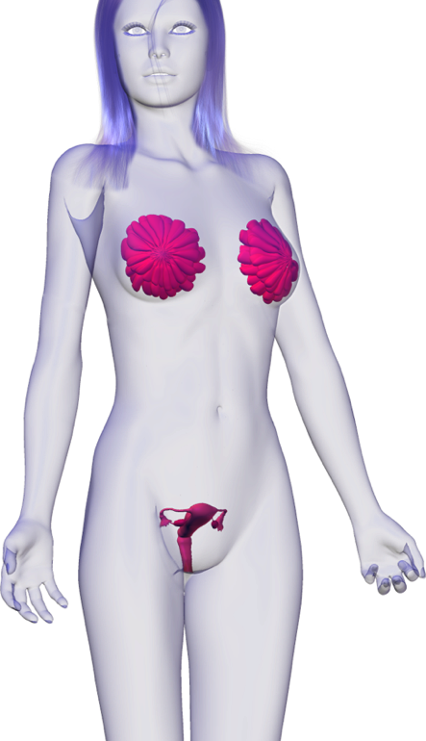
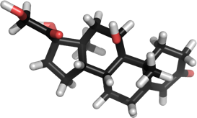
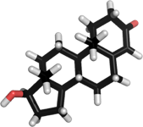
Reproductive System
The skeletal and muscular systems interact with the reproductive system.
  The skeleton protects the reproductive organs.
  Reproductive hormones influence skeletal and muscular growth and strength.
Estradiol
Testosterone

Slide 13
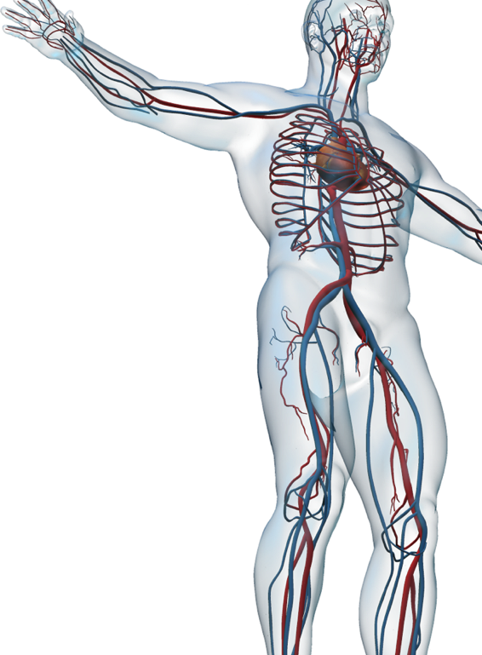
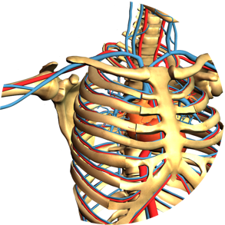
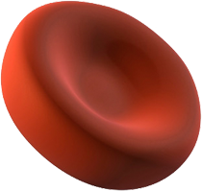
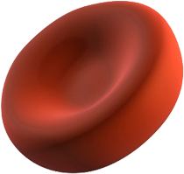
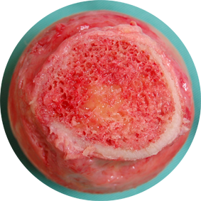
Cardiovascular System
The skeletal and muscular systems interact with the cardiovascular system.
  Heart and blood vessels transport O2, nutrients, and waste products to and from the skeleton and muscles.
  Bone matrix stores calcium, which is required for muscle contraction.
  Bone marrow produces red blood cells.
EII
Stevenfruitsmaak

Slide 14
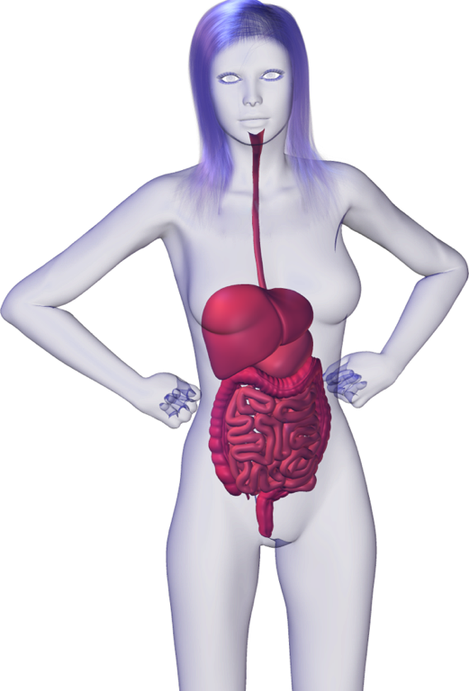
Digestive System
The skeletal and muscular systems interact with the digestive system.
  Skeleton provides some protection and support for the digestive organs.
  Digestive system provide nutrients for growth, repair, and maintenance of muscle and connective tissue.

Slide 15
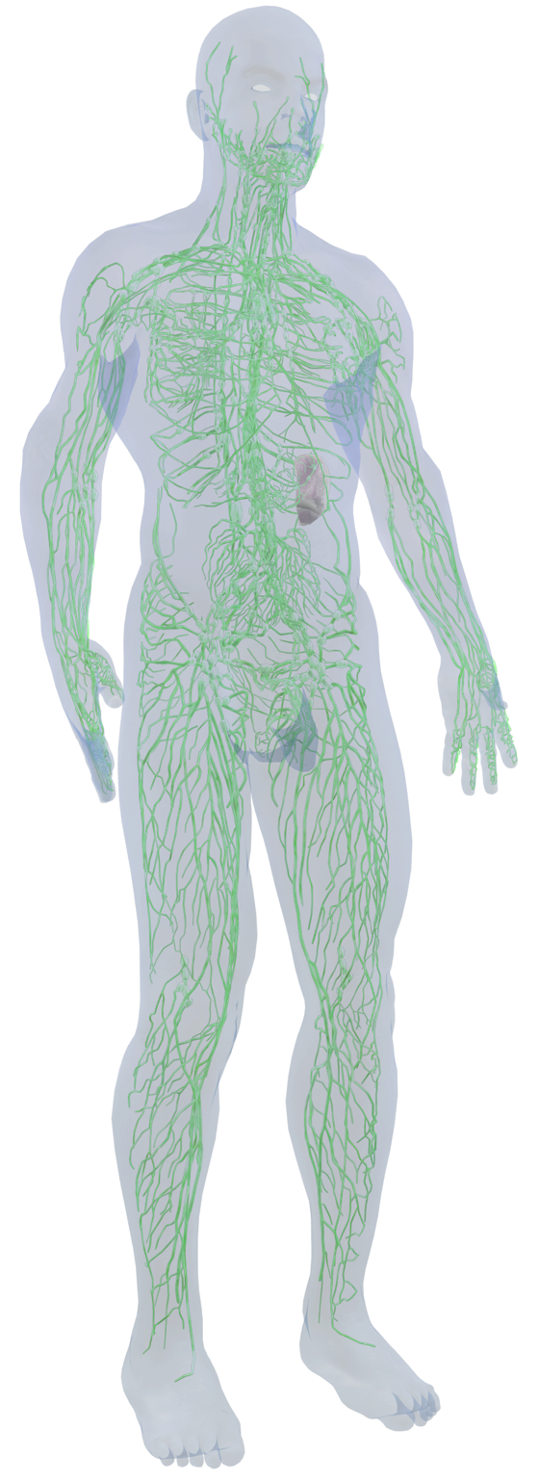
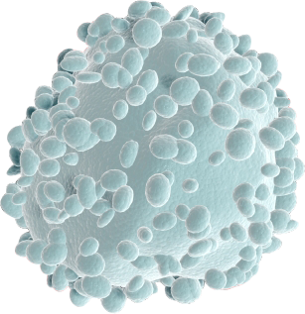
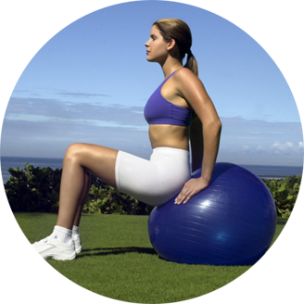
Lymphatic System
The skeletal and muscular systems interact with the lymphatic and immune systems.
  Stem cells in the bone marrow give rise to the lymphocytes involved in the immune response.
  Physical exercise may enhance or depress the immune system depending on intensity.
Stevenfruitsmaak
Istock
CA

Slide 16
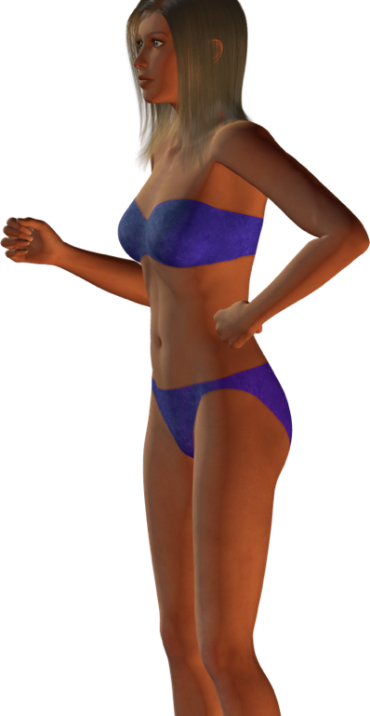
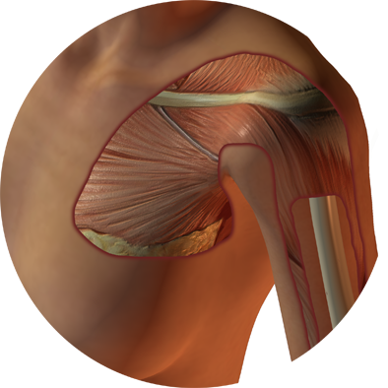
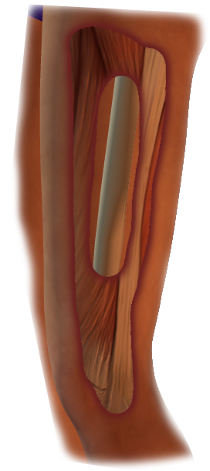
Integumentary System
The skeletal and muscular systems interact with the integumentary system.
  Skin covers and protects the muscle tissue.
  Skin absorbs UV light and produces precursor of vitamin D (previtamin D3). Vitamin D is involved in calcium and phosphorus metabolism.
Vitamin D
EII

Slide 17
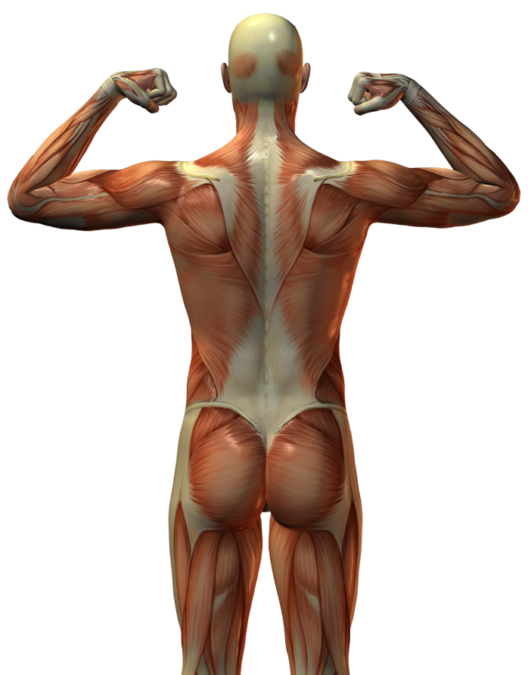
Muscular System
The skeletal system interacts with the muscular system.
  Skeleton acts as a system of levers for muscular activity.
  Bone provides a store of calcium for muscle contraction.
EII

Slide 18
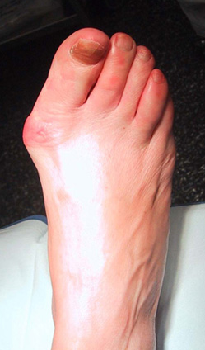
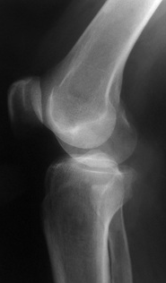
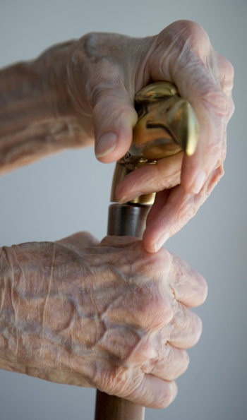
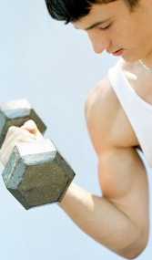
Contexts
Disease
What are the diseases of the musculoskeletal system and what are their symptoms?
Medicine and Technology
How do we prevent, diagnose, and treat disease of the musculoskeletal system?
Ed Uthman
Support and Movement
The Musculoskeletal System
The musculoskeletal system can be affected by disease and undergoes changes associated with age.
Medical technologies and exercise can be used to diagnose, treat and delay the onset of musculoskeletal disorders.
Dr Henri Lelièvre CC 1.0
photos.com
The Effects of Aging
How does aging affect the musculoskeletal system.
Exercise
What are the effects of exercise on the musculoskeletal system?
Istock
iStock
CA

Slide 19
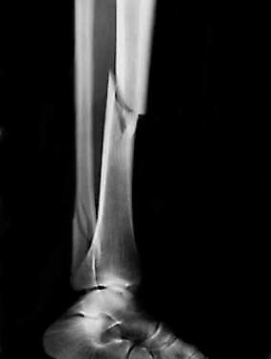
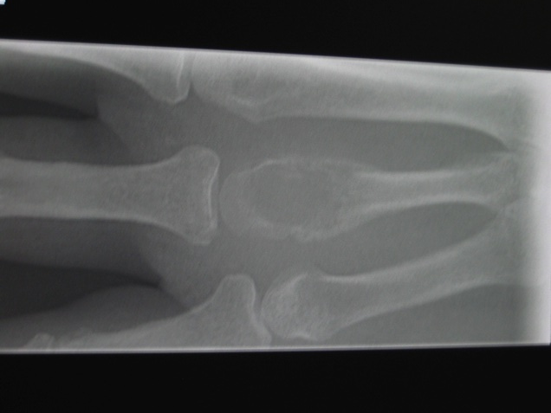
Disease
The skeletal and muscular system is prone to numerous diseases and disorders.
  Bones may be broken or develop cancer.
  Joints may be dislocated.
  Osteoarthritis and rheumatoid arthritis affect the functioning of the joints.
  Muscles and tendons may tear due to excessive force.
  Muscles may become inflamed.
Damage to the skeletal and muscular systems can make moving about extremely difficult and painful.
Fracture
AT
Bone tumor
James Heilman MD

Slide 20
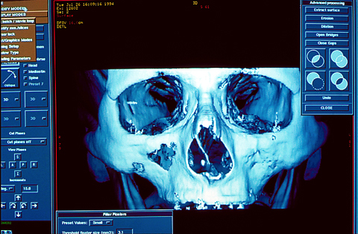

Medicine and Technology
Bones and soft tissues can now be visualized and examined with imaging techniques including:
  X-ray images are most commonly used for imaging bones and diagnosis e.g. fractures.
  Other techniques such as MRI and CT scans (right) are used when imaging soft tissue, e.g. muscle and brain.
Advances in medical techniques allow for the treatment of many musculoskeletal disorders.
  These include: bone and bone marrow transplants and reconstruction of damaged joints e.g knee reconstruction.
Inherited diseases are also treatable using similar techniques.
COR
COR

Slide 21

Diagnosis and Disorders
Diagnosis tests that can detect or confirm a disorder including:
  Blood tests
    Blood tests are routinely done to identify causes of disease e.g. antibodies in the blood (rheumatoid arthritis).
  Bone scans
    X-rays are commonly used to view a person’s bones. Bone density scanners are used in the diagnosis of osteoporosis.
  Medical imaging techniques
    CT and MRI scans can provide 3-D images of the bones and muscles.
  Arthroscopy
    Viewing and correcting damaged joints can be done by microsurgical techniques.
Bone density scanner
Kevin Vree CC

Slide 22



Effects of Age
Bones and muscles lose mass with age.
As a consequence people tend to become frail and can have difficulty moving as they become older.
Lexell J. et al

Slide 23


Exercise
Exercise has both short and long term effects on the function of the muscular and skeletal systems.
Intense, explosive activity builds large muscles that can produce forceful contractions over a short time.
Sustained, endurance activities builds lean muscle that can sustain many less forceful contractions over a long period of time.
CA
Cyclists are able to sustain aerobic activity for a long period of time.
Istock
Body builders can produce forceful muscle contractions, but only for a short period of time.

Slide 24

The Human Skeleton
Immovable joint
Axial skeleton
Appendicular skeleton
Flat bone
The human skeleton is divided into two parts:
  The axial skeleton comprises the skull, rib cage, and spine.
  The appendicular skeleton comprises the limbs and pectoral and pelvic girdles.
Bones can also be identified by their shape (flat, long, short, or irregular).
The junction of two or more bones forms a joint.
  Joints may be movable or immovable.
Short bone
Irregular bone
Long bone
Movable joint

Slide 25

The Upper Skeleton
Skull
Facial bones
Jaw (mandible)
Phalanges
Clavicle
Metacarpals
Scapula
Rib
Carpals
Radius
Humerus
Ulna
Sternum
Vertebrae

Slide 26


Pectoral Girdle
The pectoral girdle consists of the two scapulae and two clavicle bones.
The clavicle rests anteriorly and superiorly to the rib cage and articulates with the sternum and scapula.
The scapula rests posteriorly to the rib-cage and articulates with the clavicle and the humerus. It is held in position by numerous muscle attachments.
Anterior view
Posterior view
Scapula
Sternum
Scapula
Clavicle
Humerus

Slide 27

The Lower Skeleton
Spinal processes of vertebrae form the spine
Ilium
Sacrum
Femur
Patella
Fibula
Tarsals
Tibia
Metatarsals
Phalanges

Slide 28

The Pelvic Girdle
The pelvic girdle (the hipbones) consists of two hipbones (each comprising three fused bones) joined anteriorly by the pubic symphysis, and posteriorly by the sacrum.
In a newborn, each hipbone comprises three components (bones), but these fuse together as the infant grows to form one large structure.
Sacrum
Ilium
Coccyx
Ischium
LA
Pubis
Pubic symphysis

Slide 29

The Skull
The skull is made up of 22 bones.
Most are fused together to form a strong dome containing the brain and various sensory organs.
  The braincase is formed from 8 bones
  There are 14 facial bones, including the mandible.

Slide 30

The Skull
Frontal bone
Parietal bone
Sphenoid bone
Ethmoid bone
Lacrimal bone
Nasal bone
Zygomatic bone
Occipital bone
Maxilla
Temporal bone
LA
Mandible

Slide 31

The Spine
Cervical curvature (concave)
7 vertebrae C1 - C7, including atlas (C1) and axial (C2)
Together the bones of the spine form an S-shaped curve, adapted to bring the body’s center of gravity directly under the middle of the skull.
Between the bones (vertebrae) are intervertebral discs. These cushion the vertebrae and absorb shock.
The spine can be divided into five sections.
Thoracic curvature (convex)
12 vertebrae: T1 - T12 vertebrae articulate with the ribs
Lumbar curvature (concave)
5 vertebrae: L1 -L5 vertebrae are weight-bearing and sturdy
Sacral curvature (concave)
5 fused vertebrae form the posterior wall of the pelvis
Coccyx
4-5 fused vertebrae
LA

Slide 32


Typical Vertebra
Although the vertebrae in the spine vary in their size and shape they all have a similar overall plan:
Spinous process
Transverse process: Serves as an attachment point for muscles.
Body
Vertebral foramen: Encloses and protects the spinal cord.
Body: The weight -bearing, disc-shaped anterior portion of the vertebra.
Spinous process: Serves as an attachment point for muscles.
All photos: John Bath

Slide 33



Cervical Vertebrae
Atlas C1
Anterior
Superior articular facet: permits up-down movement of head.
Posterior
The cervical vertebrae of the neck are the smallest and lightest of the the vertebrae.
  The always have openings (foramina) through which the vertebral arteries pass.
  The atlas (C1) has no body and articulates with the skull, while C2 (the axis) acts as a pivot for rotation of the atlas.
Axis C2
Anterior
Superior articular facet: permits side to side rotation of the atlas and head.
Posterior
Typical cervical vertebra
Anterior
Vertebral foramen
Posterior
LA
All photos: John Bath

Slide 34


Thoracic Vertebrae
Thoracic vertebrae are larger than cervical vertebrae.
  The body is slightly heart-shaped
  The transverse processes articulate with the ribs.
  The spinous process is long and points sharply downwards.
Heart-shape body
Photo: Frank Hauser
Superior view
Transverse process
Photo: John Bath
Spinous process
Lateral view
LA

Slide 35


Lumbar Vertebrae
These feature a large block-like body and short processes.
Note the moose-head shape in the lateral view, formed by the spinious process.
Superior view
Moose-head shape
Lateral view
LA
All photos: John Bath

Slide 36

Sacrum and Coccyx
Composed of fused vertebrae.
The coccyx is a vestigial tail.
Articulation with L5
Fused spinous process make a sacral crest
Coccyx
Photo: Frank Hauser
LA

Slide 37


Bones
The skeleton is formed from two hard connective tissues, bone and cartilage.
As part of the skeleton they have 5 main functions:
  Support
  Protection
  Movement
  Mineral storage
  Blood cell formation
Although hard, bones are continually remodeled and repaired, according to needs and blood calcium levels.
PC
PC

Slide 38

Bone Structure
Proximal epiphysis
Hyaline cartilage covers the articular surface of the epiphysis. It provides a smooth surface that reduces friction at joint surfaces.
The humerus (right), has the typical structure of all long bones.
Spongy bone
Epiphyseal line is a remnant of the epiphyseal plate, which is seen young bones.
Diaphysis: the main shaft of a long bone.
Compact bone
Medullary cavity
Yellow bone marrow, which is mainly fat, fills the cavity of the shaft.
Artery supplies nutrients to the bone tissue.
The periosteum is a fibrous, connective tissue membrane covering the surface of the diaphysis
Distal epiphysis
The epiphyses are the ends of the long bone. Each has a thin layer of compact bone and central area of spongy bone. In adults, red marrow, which forms blood cells, is confined to these cavities in the spongy bone of some flat epiphyses.

Slide 39

Compact vs Spongy Bone
Not all bone is completely solid.
  Depending on size and distribution of spaces in the bone, it may be classified as compact bone (cortical bone) or spongy bone (cancellous bone).
Compact bone has very few spaces and forms the outer layer of bones.
  Compact bone if very hard and is made up of regular concentric rings of bone tissue called osteons.
Spongy bone has an irregular latticework structure of thin plates called trabeculae.
  Spongy bone is the site site of red blood cell production.
  Spongy bone makes up the bulk of the interior of the short and irregular bones.
Compact bone
Spongy bone
Stevenfruitsmaak
Head of Femur

Slide 40


Ultrastructure of Compact Bone
Cells that produce bone are called osteoblasts.
  They secrete the matrix of calcium phosphate and collagen fibers that forms rigid bone.
Once mature and embedded within the matrix, the bone cells are called osteocytes.
Compact bone has a repeating structure composed of osteons (Haversian systems).
Osteon
LA
Section through compact bone

Slide 41
Haversian Systems
Strands of tissue link bone cells
Haversian canal
Concentric lamellae innermost
Haversian canal through which arteries, veins, and nerves service surrounding bone tissue. Each complex of a central canal and matrix rings is called an osteon
Section through compact bone
Perforating canals links Haversian canals, running at right angles to the bone shaft.
Lamellae around the circumference of the bone, next to periosteum
Osteocytes
Periosteum around bone
LA

Slide 42

Osteocytes
Osteocyte in lacuna
Matrix
Osteocyte (bone cell) embedded in a lacuna within the matrix (mainly calcium phosphate and collagen). The osteocytes maintain the bone tissue.
Canaliculi
Cytoplasmic connection to neighboring cell

Slide 43

Bone Growth in Embryo
A hyaline cartilage “model” forms most of the skeleton of the embryo.
Bone length increases by the addition of cartilage at the epiphyseal plates which is then converted to bone.
Bone width increases by the growth of new bone on the outside of the diaphysis surface and the breakdown of old bone on the inside (called remodeling).
The cartilage model is first covered by a bone matrix of “bone collar”
Bone begins to replace cartilage
Embryonic bone

Slide 44

Bone Growth in Fetus
Hyaline cartilage
New center of bone growth
Bone grows in length by continuous growth of new cartilage in the epiphyseal plate, which is then replaced by new bone.
Growth in length
Blood supply
Medullary cavity where cartilage digested away
Fetal bone

Slide 45

Bone Growth in a Child
Articular cartilage
Epiphyseal plate
By birth, most of the cartilage has been replaced by bone.
Cartilage still remains at the articular cartilage and the epiphyseal plates.
New bone forming
Growth in width (appositional growth)
New bone forming
Epiphyseal plate
Child’s Bone

Slide 46





Long Bones
Humerus (upper arm): the largest bone in the upper limbs
Long bones are longer than they are wide:
  They include most bones of the upper and lower limbs.
Radius (forearm)
Ulna
Femur (upper leg): the longest, heaviest, and strongest bone in the body.
Fibula (lower leg)
Tibia

Slide 47




Short Bones
Short bones are roughly cube shaped and contain mostly spongy bone.
They include:
  the carpals (hands)
  tarsals (feet)
  patella (knee joint)
Tarsals
Carpals
Patella. This bone increases the leverage of the tendon of the quadriceps femoris muscle.

Slide 48





Flat Bones
Flat bones have a thin flattened shape.
They include:
  the ribs
  sternum
  scapulae (shoulder bone)
  some skull bones
Ribs
Scapula

Slide 49




Irregular Bones
Irregular bones have an irregular shape and do not fit in the other groups mentioned.
They include:
  vertebrae
  hip bones
  facial bones
Ilium
Vertebrae
Pubis
Ischium
Hip: the hip is made of three parts. The ilium (superior broad faced bone), the ischium (inferior, posterior bone), and the pubis (interior, anterior bone)

Slide 50

Symptoms of Disease
Symptoms of disease or infection of the musculoskeletal system include:
  Pain
    Pain caused by inflammation of joints
    and muscle can make movement
    very difficult.
  Inflammation
    Inflammation may be due to trauma or of infection.
  Limitation in function
    Loss or limitation in movement of muscles or joints may be related to infection, trauma or degenerative disorders.
Istock

Slide 51

Skeletal Disorders
Skeletal disorders are typically associated with pain and/or loss of mobility:
  Growth disorders
    Failure to gain the required nutrients may cause abnormal development of the skeleton e.g. rickets.
  Trauma
    Excessive force on the bones may cause fractures.
    Excessive twisting (torsion) of joints can cause dislocation.
  Infection
    Infection may occur after damage to the bone, causing pain, swelling, and greater damage.
  Tumors
    Tumors most commonly occur in the long bones.
  Degenerative diseases
    Diseases such as osteoarthritis cause progressive, irreversible damage to the skeletal system.
Rickets caused by vitamin D deficiency
ART

Slide 52

Inherited Disorders
The progressive damage caused by inherited disorders can be alleviated by current medical techniques.
  Surgery
    Surgery can be used to repair damaged joints.
  Physical and drug therapies
    Drugs can be used to help alleviate joint or muscle damage.
  Prosthetics and orthotics
    Braces and other aids can be used to help correctly align bones.
  Gene therapy
    Gene therapy may help in the regeneration of bone tissue.
CA

Slide 53

Joints
Bones are too rigid to bend.
  Joints are required between the individual bones to enable movement of the skeleton.
Bones are held together at movable joints by connective tissues called ligaments.
Joints may be movable or immovable.
Joints may also be cartilaginous joints (joined by cartilage), fibrous joints (joined by connective tissues including collagen), or synovial joints (not directly joined but the bones are united in a synovial capsule).
Posterior view of left knee
PC

Slide 54

Synovial Joints
Quadriceps muscle
Quadriceps tendon (holds muscle to the bone)
Synovial joints allow free movement in one or more planes.
The articulating bone ends are separated by a joint cavity containing lubricating synovial fluid.
Hyaline cartilage
Patella (knee cap)
Fibrous capsule encloses joint
Synovial membrane secretes lubricating synovial fluid
Joint capsule containing synovial fluid
The knee joint is a typical synovial joint. Like most synovial joints, it is reinforced by ligaments (most are not shown here).
The patella ligament is an extension of the quadriceps tendon

Slide 55

Properties of Synovial Fluid
The synovial fluid fills the synovial cavity.
It reduces friction between bones in the joint as well as supplying nutrients and removing wastes from the cartilage.
Synovial fluid contains phagocytes to remove microbes and debris caused by joint movement.
Synovial fluid is a non-newtonian fluid in that under low stress it is relatively viscous but, as stress increases, its viscosity deceases.
Synovial fluid has the consistency of raw egg white.

Slide 56



Ball and Socket Joint
Ball and socket joints allow rotation of the joint in almost any direction.
The only examples of ball and socket joints in humans are the hip and shoulder joints.
The shoulder joint allows the complete 360º rotation of the arm, as in pitching a ball. This is called circumduction.
LA
Socket
Ball
Hip joint

Slide 57


Hinge Joint
A hinge joint allows movement of the joint along one plane only.
Hinge joints include the knee, elbow, and joints between the phalanges.
The hinge joint allows flexion and extension (as in opening and closing a fist).
LA
Elbow joint

Slide 58


Saddle Joint
A saddle joint allows free movement along two planes.
The joint between the carpals and metacarpals of the thumb is an example of a saddle joint.
  The saddle joint in the thumb allows circumduction and opposition of the thumb with the fingers.
LA
Saddle joint
Opposition
Bones of the hand

Slide 59


Condyloid Joint
A condyloid joint allows free movement in two planes.
The joint at the wrist, between the radius and carpals, is a condyloid joint. It allows the rotation of the wrist.
The knuckles of the hand, the joints between the metacarpals and phalanges, are also condyloid joints.
LA
Radius
Condyloid joint
Sacphoid
Bones of the hand

Slide 60


Pivot Joint
Pivot joints allow rotation around the longitudinal axis of the bone.
Pivot joints are found in the neck between the atlas and axis and in the elbow between the radius and ulna.
LA
Pivot joint
Ulna
Radius
Bones of the forearm

Slide 61


Gliding Joint
Gliding joints allow side-to-side and back-and-forth movements.
The intercarpal and intertarsal joints are gliding joints.
  The movements are very small and allow for flexing of the hands and feet.
LA
Navicular
Gliding joint
Third cuneiform
Second cuneiform
Bones of the foot

Slide 62


Fibrous Joints
Fibrous joints are held together by fibrous connective tissue.
In some (e.g. sutures of the skull), the bones are tightly bound by connective tissue fibers and there is no movement.
Tibia
Fibula
Fibrous joints of the skull
PC
In some fibrous joints, the connective tissue fibers joining the bones are long enough to allow very slight give in the joint.

Slide 63



Cartilaginous Joints
In cartilaginous joints, the bone ends are cushioned by cartilage.
Most allow limited movement, although some (e.g. between the ribs and sternum) are immovable.
PC
PC
PC
Intervertebral discs of fibrocartilage between vertebrae
Hyaline cartilage forms the immovable joint between rib 1 and the sternum
Fibrocartilage connecting the pubic bones anteriorly

Slide 64


Movements at Joints
Muscle pulling on a joint allows the angle between the articulated bones to change.
The type of movement and change of angle are described with reference to the anatomical position and the articulating bones.
Flexion is the decrease in angle between the articulating bones, such as when bending the arm upwards at the elbow.
Hyperextension is the continuation of extension beyond the anatomical position.
Flexion
Hyperextension
Extension
Extension is the opposite of flexion. It increases the angle between the articulated bones, e.g. bending the arm down at the elbow or unclasping a closed fist.

Slide 65



Abduction and Adduction
Abduction refers to movements of bones away from the midline of the body. Examples include moving one leg outwards while balancing on the other, and raising the arm outwards from the side of the body.
Adduction refers to the movement of bones towards the midline of the body.
Abduction
Adduction
Abduction
Adduction

Slide 66





Small Scale Movements
Elevation is the upward movement of a part of the body, and depression is the lowering of a part of the body
Protraction is the movement of the mandible or shoulder girdle forward along a plane parallel to the ground. Retraction is the reverse of this movement.
Inversion moves the soles inwards so that they face each other. Eversion moves them outwards, away from each other.
Elevation
Protraction
Depression
Retraction
Inversion
Eversion

Slide 67

Aging and the Skeleton
Aging refers to the progressive decline in the body’s systems as a result of cells dying and cell renewal rates slowing or stopping.
  After the body reaches physical maturity, it undergoes progressive degenerative changes known as senescence or aging.
  Aging results in observable changes
  in the structure and function of the body,
  and is associated with a decline in
  skeletal and muscular strength and
  reduced immune function.
  Aging also increases the vulnerability
  to stress and disease and reduces the
  ability to recover from illness.
Photo: Art Today

Slide 68

Muscles, Bones, Joints and Age
As the body ages, the musculoskeletal system wears out.
  Bone loss
    After menopause women lose bone faster than men.
  Loss of muscle mass
    Muscle mass can be maintained by exercise but typically around 20% of muscle mass is lost by age 80.
  Accumulated trauma
    Accumulated damage to the muscles and bone can lead to pain and loss of mobility later in life.
  Increased incidence of cancers
    Unusually for cancers, bone cancer is most common in young adults. It may be linked to rapid bone growth during puberty.
RA

Slide 69

Osteoarthritis
Osteoarthritis is a common degenerative disease aggravated by mechanical stress on bone joints.
  Osteoarthritis is characterized by the degeneration of cartilage and the formation of osteophytes (bony outgrowths at the joint). This leads to:
    pain
    stiffness
    inflammation
    full or partial loss of joint function.
  Osteoarthritis occurs in almost all people over the age of 60 and affects three times as many women as men.
Osteoarthritis of the knee joint
Loss of lubricating fluid and cartilage
Osteophytes

Slide 70


Osteoporosis
Osteoporosis is an age-related disorder where bone mass decreases, and there is a loss of height and an increased tendency for bones to break (fracture).
Women are at greater risk of developing the disease than men because their skeletons are lighter and estrogen levels fall after menopause (estrogen provides some protection against bone loss).
Osteoporosis affects the whole skeleton, but especially the spine, hips, and legs.
Loss of height
Hunching of the spine
Osteoporosis of the spine
R. Allan

Slide 71


Skeletal Muscle
There are three kinds of muscle tissue: skeletal, cardiac, and smooth.
  Each has a distinct structure as a result of the regular arrangement of contractile elements.
Skeletal muscle is also called striated or striped muscle.
  It has a banded appearance under high power microscopy.
  Sometimes it is called voluntary muscle because it is under conscious control.
  The cells are large with many nuclei at the edge of each cell.
EII
Light microscope image of skeletal muscle
LA
Simplified diagram of skeletal muscle

Slide 72


Cardiac Muscle
Cardiac muscle is specialized striated muscle that does not fatigue.
Cells branch and connect with each other to assist the passage of nerve impulses through the muscle.
Cardiac muscle is not under conscious control (it is involuntary).
EII
Light microscope image of cardiac muscle
LA
Simplified diagram of cardiac muscle

Slide 73


Smooth Muscle
Smooth muscle is also called involuntary muscle because it is not under conscious control.
Contractile filaments are irregularly arranged so the contraction is not coordinated in one direction as it is in skeletal muscle.
Cells are spindle shaped with one central nucleus.
EII
Light microscope image of smooth muscle
LA
Simplified diagram of smooth muscle

Slide 74


Skeletal Muscle Structure
Skeletal muscle is organized into bundles of muscles cells (fibers).
Each fiber is a single cell with many nuclei, and is composed of a bundle of smaller myofibrils, all arranged lengthwise.
Skeletal muscle enclosed in connective tissue epimysium
Bundles of muscle fibers (fascicles) enclosed in fibrous perimysium
Single muscle fiber (cell)

Slide 75


Muscle Fiber Structure
Each myofibril in the muscle fiber is composed of two kinds of myofilaments - thick and thin - which overlap to form light and dark bands.
  This banding gives skeletal muscle its striated appearance.
Branch of motor neuron.
An action potential is conducted to all myofibrils of the muscle fiber.
Muscle fiber
Myofibril
Peripheral nucleus
Myofilament
Sarcoplasmic reticulum: a network of membranous tubules containing a store of calcium ions required for muscle contraction.
Sacrolemma
(plasma membrane)

Slide 76

Neuromuscular Junction
The neuromuscular junction is the synapse of a motor neuron with a motor end plate (the post-synaptic membrane of the muscle fiber).
The signal from the motor neuron is transmitted to the motor end plate via the neurotransmitter acetylcholine.
A motor neuron and all the fibers it innervates is called a motor unit.
Synaptic vessel containing acetylcholine
Synaptic end bulb
Direction of nerve impulse
Muscle action potential
Synaptic cleft
Motor end plate
Sarcolemma (plasma membrane)

Slide 77

Sarcomere Structure
The thick and thin myofilaments overlap to form the sarcomere
The sarcomere is the contractile unit that allows muscle contraction.
  It is bounded by Z lines.
I band (light)
A band (dark)
I band (light)
Myofilament
One sarcomere
Z line
H zone
Z line
Muscles contract when the actin and myosin filaments slide past one another
Thin filament made of actin
Thick filament made of myosin

Slide 78


Muscle Movement
Muscle fibers respond threshold stimuli by contracting.
  They either contract maximally or not at all. This is called the all-or-nothing law.
Graded responses in contraction of a whole muscle are achieved by:
  Changing the frequency of the nervous stimulation.
  Changing the number of motor units recruited.
EII
The branches of the nerve axon terminate on the sarcolemma of a muscle fiber at a region called the neuromuscular junction. Each fiber receives a branch of the axon, but one axon may supply many muscle fibers.
COR
Maximal contractions of a muscle are achieved when nerve impulses arrive at the muscle at a rapid rate and a large number of motor units are active at once.

Slide 79
Sliding Filament Theory
The thin myofilament (made of actin) and the thick myofilament (made of myosin) produce muscle contraction by sliding past each other.
This sliding is produced by cross bridges on the thick filament linking to the thin filament.
  Stimulation by nerve impulses causes these cross bridges to change shape, thus moving the thin filament relative to the thin filament.
1
Blocking complex of protein molecule (troponin and tropomyosin)
Thin filament
Actin molecules: two are twisted together in a double helix (shown here as a bar)
In a relaxed muscle, the binding sites on the actin molecule for the myosin cross-bridges are blocked by a complex of two proteins: troponin and tropomyosin.

Slide 80




Sliding Filament Theory
2
Ca²⁺
Ca²⁺
Ca²⁺
Ca²⁺
Arrival of an action potential causes a release of Ca²⁺ ions from the sarcoplasmic reticulum.
Thin filament
Myson-binding site unblocked
The Ca²⁺ binds to the troponin and causes the blocking complex to move so that the myosin binding sites on the thin filament become exposed.
Thick filament
ATP
ATP
ATP
ATP
Prior to muscle contraction, ATP binds to the “heads” of the myosin cross-linkages, priming them in a high energy state.
3
The heads of the cross-bridging myosin molecules attach to the binding sites on the actin filament.
ATP
ATP
ATP
ATP
Release of energy from the hydrolysis of ATP accompanies the cross bridge formation.

Slide 81


Sliding Filament Theory
4
Ca²⁺
Ca²⁺
Ca²⁺
Ca²⁺
The energy released by the hydrolysis of ATP causes a change in the shape of the myosin cross link, resulting in a bending action (the power stroke). This causes the actin filaments to slide past the myosin filaments, towards the center of the sarcomere.
Thin filament
Thick filament
5
Ca²⁺
Ca²⁺
Ca²⁺
Ca²⁺
Fresh ATP attaches to the myosin molecules, releasing them from the binding sites and re-priming them for a repeat movement. They become attached further along the actin chain as long as ATP and Ca²⁺ are available.
ATP
ATP
ATP
ATP

Slide 82

Rigor Mortis
After death autolysis of muscle fibers causes calcium ions to leak out of the sarcoplasmic reticulum.
The calcium ions bind to troponin and cause the formation of myosin cross-bridges to actin.
However, because ATP is no longer being made (no cellular respiration), the myosin molecules cannot detach from the actin.
This results in the muscles being in a state of rigidity and can neither contract or stretch.
This effect, called rigor mortis, disappears after about 24 hours.
Sacroplasmic reticulum breaks down after death, releasing Ca²⁺ ions
Ca²⁺
Ca²⁺
Ca²⁺ ions bind to troponin an d cause myosin-actin cross-bridges.
Without ATP to release the myosin the muscle become rigid and locked into place.

Slide 83


Muscles of the Body
Biceps brachii
Trapezius
Deltoid
Trapezius
Pectoralis major
Triceps brachii
Rectus abdominis
Latissimus dorsi
External oblique
Sartorius
Gluteus maximus
Rectus femoris (quadriceps)
Biceps femoris
Semitendinosus
Tibialis anterior
Gastrocnemius
Peroneus longus

Slide 84

Facial Muscles
Facial muscles are used to move the skin of the face to convey expressions.
Frontalis
Temporo-parietalis
Corrugator supercilii
Procerus
Nasalis
Orbicularis oculi
Levator anguli oris
Levator labii superioris
Buccinator
Zygomaticus minor
Orbicularis oris
Zygomaticus major
Depressor labii inferioris
Masseter
Depressor anguli oris
Mentalis

Slide 85

Facial Expressions: Frowning
Procerus: draws the skin above the nose and between the eyebrows downwards, causing the wrinkle above the nose (“fold of the fighters”).
Corrugator supercilii: pulls the eyebrows together and downwards, causing the wrinkle that occurs between the eyebrows during a frown.
Orbicularis oculi: closes the eyelids to narrow the eyes. The external portions drag the skin of the cheek slightly upwards (producing “crows feet”).
Depressor anguli oris: pulls the corners of the mouth down, producing an inverted U shape of the mouth.
Nasalis: pulls skin towards the back of the nose, producing wrinkles at the corners of the nostrils.
It is estimated that eleven muscles in total are used in frowning. However this depends greatly on what one calls a frown and on the extent of the frown.

Slide 86

Facial Expressions: Smiling
Levator anguli oris: Raises the upper lip so that the canine teeth become visible (hence its other name of caninus)
Levator labii superioris: raises the edges of the nose and central portion of the upper lip.
Zygomaticus minor: raises the upper lip’s outer edge.
Zygomaticus major: raises the corners of the mouth and produces the “cheek dimples” present when smiling.
It is estimated that twelve muscles in total are used in smiling. However this depends greatly on what one calls a smile and on the extent of the smile.

Slide 87

Diseases of the Muscles
Disorders of the muscular system can make it very difficult for affected people to move about.
  Inherited diseases
    Diseases such as muscular dystrophy cause degeneration of the muscle tissue.
  Fibrosis
    Scarring of the muscle tissue makes movement difficult.
  Strains, tears, and cramps.
    Excessive physical force or over-stretching can cause strains (in which the muscle fibers tear apart) in muscle tissue. Cramps may be caused by a localized lack of minerals (particularly sodium, potassium, or magnesium).
  Denervation and atrophy
    Decreases in muscle mass lead to a loss of contractile strength in the muscle.

Slide 88


Contractions
Contractions in which the muscle shortens in the usual way (as in moving an arm upwards) are called isotonic contractions: shortening of the muscle causes movement.
Contraction of the muscle in which the muscle does not shorten (such as pushing on a wall) are called isometric contractions.
  The muscle produces force, but there is no change in its length (e.g. holding up an object).
Muscles can only pull, not push, so movement back and forth is achieved by using opposing pairs of muscles.
Photo: Gonzo-wiki
Performing the “iron cross” requires numerous isometric contractions.
Isotonic contractions cause shortening of the muscles.

Slide 89

Origin and Insertion
Muscles always have at least two attachments to the bones: the origin and the insertion.
The more obvious biceps brachii is a two headed muscle with two origins and a common insertion near the elbow joint. Its acts as the synergist during flexion of the arm.
Origin - the attachment to the less moveable bone
The brachialis underlies the biceps brachii. It has an origin half way up the humerus, is the primer mover in flexion of the arm.
Insertion - the attachment to the movable bone. During contraction, the insertion moves towards the origin.

Slide 90



Mechanics of Movement
The skeleton works as a system of levers, with the muscles providing the force required to move these levers.
  The joint acts as the fulcrum (F), the muscles exert the effort force (E) and the weight of the bone being moved represents the load (L).
    There are three classes of levers, examples in the body are shown below:
F
E
E
E
L
L
L
F
F
L
E
L
E
E
L
F
F
F
First class levers
(load - fulcrum - effort)
Second class levers
(fulcrum - load - effort)
Third class levers
(fulcrum - effort - load)

Slide 91

Antagonistic Muscles
The flexion and extension of the limbs (as well as the various movements of other body parts) is caused by the action of antagonistic muscles.
  Antagonistic muscles oppose each other’s actions.
Muscles can be classed as the following:
  Agonists (prime movers): muscles that primarily responsible for the movement and produce most of the force.
  Antagonists: muscles that oppose the prime mover. They also prevent over-stretching of the prime mover by contracting very slightly when the prime mover contracts.
  Synergists: muscles that assist the primer mover and may be involved in fine-tuning the movement.
The biceps brachii acts as the synergist when flexing the arm.
The brachialis acts as the agonist when flexing the arm.
The triceps brachii acts as the antagonist when flexing the arm. When extending the arm, it will act as the agonist.

Slide 92



Energy for Contraction
The ability of the muscles to continue contracting and relaxing over any length of time depends on the body’s ability to deliver an adequate supply of ATP to those muscles.
There are three systems that the body uses to do this:
  The ATP-CP system
  The glycolytic system
  The oxidative system
The glycolytic system provides energy for a few minutes of intense exercise.
The oxidative system provides ATP for a prolonged aerobic effort.
The ATP-CP system provides energy to fuel about 10 seconds of maximum effort.
USAF
CA

Slide 93

The ATP-CP System
This is the simplest energy system.
Creatine phosphate (CP) is a high energy compound that stores energy energy sufficient for brief periods of muscular activity.
  The energy released from CP is used to rebuild ATP and maintain the supply.
  The process is anaerobic and occurs very rapidly.
The ability of the ATP-CP system to maintain energy levels is limited to between 3-15 seconds during an all-out sprint.
  Beyond this, the muscle must rely on other processes for ATP generation.
CP
Creatine kinase separates Pi from creatine
Pi
Creatine
Energy
Energy is used to join ADP and Pi
Pi
ADP
A source of energy for muscle contraction
ATP

Slide 94

The Glycolytic System
ATP can also be produce by glycolysis.
  Glycolysis uses glucose in the blood or glycogen stored in the muscles.
  The ATP yield from glycolysis is low (about 2 molecules for every molecule of glucose).
  The process is rapid and does not require oxygen.
Glycolysis provides energy for exercise for just a few minutes.
Its main disadvantage to the body is that is it produces lactic acid and contributes to the feeling of muscle fatigue.
Glucose
Glycogen
ATP
Glucose-6-phosphate
ATP
Glycolytic enzymes
Net yield
Pyruvic acid
Lactic acid

Slide 95
The Oxidative System
Glycogen
Triglycerides
In the oxidative system, glucose is completely broken down to yield about 36 molecules of ATP.
  The process is aerobic and takes place in the mitochondria.
  It is the primary method of energy production during sustained high activity.
The process is reliant on the ability of the body to deliver oxygen to the muscles.
  The fuels for the oxidative system are glucose, glycogen, or stored triglycerides.
Glycolysis
β-oxidation
Acetyl CoA
Krebs cycle
ATP
Electron transport chain
ATP

Slide 96
VO2
VO2max (ml kg⁻¹ min⁻¹) for age groups
Age | Males | Females
10-19 | 47-56 | 36-46
20-29 | 43-52 | 33-42
30-39 | 39-48 | 30-38
40-49 | 36-44 | 26-35
50-59 | 34-41 | 24-33
60-69 | 31-38 | 22-30
70-79 | 28-35 | 20-27
VO2 is the amount of oxygen (expressed as a volume) used by the muscles during a specified interval for cell metabolism and energy production.
VO2max is the maximum volume of oxygen that can be delivered and used per minute and therefore represents an individual's maximum aerobic metabolism.
  In trained athletes VO2max is high.
At some percentage of VO2max the body is unable to meet its energy demands aerobically and an oxygen debt is incurred.
VO2max (ml kg⁻¹ min⁻¹) for athletes
Sport | Age of competitors | Males | Females
Cycling | 18-26 | 62-74 | 47-57
Rowing | 20-35 | 60-72 | 58-65
Alpine skiing | 18-30 | 57-68 | 50-55
Swimming | 10-25 | 50-70 | 40-60
Running | 18-39 | 60-85 | 50-75
Wilmore and Costill 2005

Slide 97

Effects of Exercise
Exercise can have many positive effects on the musculoskeletal system.
  Increased bone density
    Regular weight bearing exercise through the growing years (up to age 30) causes bone to respond by becoming thicker and stronger.
  Increase lean muscle mass
    Physical activity causes muscle fibers to enlarge and contract with greater force.
  Changes in flexibility and joint mobility.
    Muscles and joints become more flexible with regular use and movement.
  Changes in fiber type and recruitment
    Training regimes can change the proportions of muscle fibers that are used during an activity.
  Changes in oxidative capacity
    Exercise (particularly regular training) can increase the oxygen capacity in muscle cells.
CA

Slide 98


Exercise and Recovery
In the example below, an aerobic activity requires 3 L of oxygen per minute.
  It takes six minutes of exercise before oxygen uptake increases to this level, creating an oxygen deficit - the amount of oxygen needed for aerobic energy supply not supplied by breathing.
  For the first six minutes, energy is largely supplied by the ATP-CP and glycolytic systems.
After exercise, oxygen uptake drops slowly as extra oxygen is taken up to repay the oxygen debt.
Oxygen deficit
The length of the recovery period depends on the size of the oxygen debt and the aerobic fitness of the individual.
Oxygen consumed during exercise
Oxygen debt
Hemera

Slide 99

Muscle Tone
When a muscle is relaxed, a few of the muscle fibers remain involuntarily contracted.
  This passive and partial contraction is responsible for muscle tone and is important in maintaining posture.
  The contractions give the healthy, firm appearance of muscle.
The amount of muscle contraction is monitored by sensory receptors in the muscle called muscle spindle organs.
  Abnormally low muscle tone (hypotonia) can arise as a result of traumatic or degenerative nerve damage so that the muscle no longer receives the innervation it needs to contract.
CA

Slide 100

Posture
We are not usually aware of the skeletal muscles that maintain posture, even though they are working almost continuously to maintain body posture and position.
Postural and functional movements of the body are highly dependent upon the body’s core muscles.
  These include the muscles of the pelvic floor, abdomen, and mid and lower back.
The core muscles stabilize the thorax and the pelvis.
  A lack of core strength is a major cause of postural problems.
CA
We don’t usually notice our postural muscles until we have to stand still, (as in waiting in a cue), then we very quickly realize how much effort is required to stand up straight.

Slide 101

Physical Therapy
Muscles that have suffered trauma or disuse may require physical therapy to restore their functionality.
Muscles that are not used atrophy and lose both mass and strength.
Physical therapy is concerned with maintaining or restoring functional movement of the body through life.
The type of therapy administered depends on the problem, but usually includes therapeutic exercises to restore strength and mobility, and prevent loss of muscle tissue.
CA

Slide 102

Treatment of Injury
Injuries to the bones and muscles can be treated using a range of techniques both specialized and simple.
  Surgery
    Surgery may be needed to reattach tendons or rebuild joints.
  Physical and drug therapies
    Physical therapists can apply techniques and movements of joints and muscles to help with their healing.
  Prosthetics and orthotics
    Where limbs or joints have been so damaged they have had to be removed, artificial limbs and joints can replace them.
CA

Slide 103

Muscle Spindle Organ
Changes in the length of the muscle is monitored by the muscle spindle organ, a stretch receptor located within the skeletal muscles, parallel to the muscle fibers themselves.
  Sensory information from the muscle spindle is relayed to the spinal cord.
  The motor response brings about adjustments to the degree of stretch in the muscle.
Motor nerves send impulses to adjust the degree of contraction in the intrafusal and extrafusal fibers.
Sensory nerves monitor stretch in the non-contractile region of the spindle and send impulses to the spinal cord.
Striated appearance of contractile elements.
The spindle is surrounded by the muscle fibers of the skeletal muscle.
The muscle spindle organ comprises special intrafusal fibers, within a lymph-filled capsule. Only the regions near the end can contract.
Nucleus of muscle fiber

Slide 104
Muscle Fatigue
At Rest
Muscles produce a surplus of ATP
This extra energy is stored in CP
and glycogen
Muscle fatigue refers to the decline in a muscle’s ability to maintain force in a prolonged or repeated contraction.
During strenuous activity, the oxygen demand of the working muscles exceeds supply and the muscle metabolizes anaerobically
  This causes the build up of lactic acid and contributes to muscle fatigue.
  The lactic acid is carried by the bloodstream to the liver where it is reconverted to glucose via the Cori cycle.
  This requires energy from aerobic respiration and accounts for the oxygen debt and results in the heavy breathing after exercise has stopped.
During Moderate Activity
ATP requirements are met by the
aerobic metabolism of glycogen
and lipids.
During Peak Activity
Effort is limited by ATP. ATP
production is ultimately limited
by availability of oxygen
During short term, intense
activity, ATP is increased through
anaerobic metabolism of glycogen.
A by-product of this is lactic acid,
which lowers tissue pH and affects
cellular activity.
When fatigued, the muscles can
no longer contract fully.

Slide 105
Lactic Acid and Fatigue
Lactic acid is a by-product of ATP production through anaerobic metabolism.
  Lactic acid accumulation lowers tissue pH and inhibits they activity of key enzymes involved in ATP production.
  The resulting decline in ATP production and supply limits muscular performance.
Together with the effects of ATP and creatine phosphate breakdown, lactic acid build up acts to slow the release of calcium ions and affects the ion pumps which move calcium ions back into the sarcoplasmic reticulum.
This contributes to fatigue because calcium ions are a key component of muscle contraction.
Increased lactic acid
Decline in pH
Elevated Pi
Decline in ATP
Fall in Ca²⁺ release
Fatigue

Slide 106

Muscle Fibers
Muscle fibers come in two types, slow twitch (type I) and fast twitch (type II).
  Fast twitch fibers predominate in explosive anaerobic activity, while slow twitch fibers predominate in aerobic endurance activity.
Training can increase the fiber size, but not the proportion of fast twitch to slow twitch fibers (which is genetically determined).
Features of Fast Twitch and Slow Twitch Fibers
Feature | Fast Twitch | Slow Twitch
Color | White | Red
Diameter | Large | Small
Contraction rate | Fast | Slow
ATP production | Fast | Slow
Metabolism | Anaerobic | Aerobic
Rate of fatigue | Fast | Slow
Power | High | Low
Fast twitch fibers produce their force at a much greater rate than slow twitch fibers. They are therefore important when great force within a short time frame is required (such as weightlifting (above), or sprinting). Slow twitch fibers contain a greater amount of mitochondria and myoglobin, making them more efficient at using oxygen.

Slide 107




Effects of Training
Aerobic training conditions the cardiovascular, musculoskeletal, and respiratory systems.
Increased capacity of the muscles to oxidize fats allows muscle and liver glycogen to be used at a slower rate. The body also becomes more efficient at mobilizing free fatty acids from adipose tissue to use as fuel.
Training increases the capacity of skeletal muscles to generate ATP aerobically by improved oxidation of glycogen.
Increased myoglobin content, which stores oxygen in the muscle cells
and aids oxygen delivery to the mitochondria. Endurance training increases muscle myoglobin by 75-80%
The size of the slow twitch muscle fibers increase, increasing aerobic capacity.
Size and density of mitochondria in the skeletal muscles increases, as does activity and concentration of Krebs cycle enzymes.
Increase in lean muscle mass and decrease in body fat. Trained athletes typically have body fat levels body that of non-athletes.
CA
The number of capillaries surrounding each muscle fiber increases by 5%-10% in trained athletes over non-athletes.

Slide 108
Androgens | Generic steroid hormone that controls the development and maintenance of male characteristics and forms the precursor to estrogens (female hormones).
Actin | A globular protein found in all eukaryotic cells. It is the only component of microfilaments (in cell cytoskeleton) and thin filaments (in muscle cells).
Adipose | Fat tissue
Aerobic | Requiring oxygen to complete the reaction. Oxygen is used as an electron acceptor in metabolic reactions.
Anaerobic | Reaction which does not require oxygen to go to completion.
Anatomical position | A standard body position allowing the orientation of body parts to be described. The position requires the subject to stand erect, facing forward, arms at sides with palms facing forward and feet flat on the ground.
Articulate | Joining together of two (or more) objects with a joint which allows the motion of both parts.
ATP | A nucleotide comprising a purine base, a pentose sugar, and three phosphate groups, which acts as the cell’s energy carrier.
Cartilage | Connective tissue consisting chrondrocytes embedded in a network of collagen and elastic fibers and a matrix of chondroitin sulfate.
Extrafusal | Muscle fiber found outside the muscle spindle organ in striated muscle.
Hormones | A chemical messenger that induces a specific physiological response in a target tissue.
Hyaline cartilage | One of three cartilage types in the body. Found in many parts of the body, but in particular the ends of bones where they form joints. It is also the cartilage in the fetus that undergoes offication to to form bone.

Slide 109
Innervation | The distribution or supply of nerves to a body part or organ.
Intrafusal | The muscles fibers in striated muscle that comprise the muscle spindle organ.
Lean muscle mass | The total weight of muscle in the body minus any fat content.
Myosin | Myosin are a large group of proteins. Myosin II is responsible for the contractile properties of muscle cells.
Tumor | An abnormal growth of tissue due to excessive and rapid cell division.
Vestigial | Degenerated body part that has lost its original function.

Slide 110


Slide 111
Conditions of Use
NOTE: Presentation Media = presentations available on CD-ROM/DVD-ROM or as downloads
BIOZONE retains copyright to the intellectual property included in the Presentation Media files, with acknowledgement that certain photos are used under license and are credited appropriately.
You MAY:
Use the Presentation Media files for presentations in your classrooms using a
data projector, interactive whiteboard or overhead projector.
Place the Presentation Media files on any staff computer within the school,
including staff laptops, but not in contradiction to clause (g).
Place the Presentation Media files on:
  The school’s intranet (school computer network)
  VLE (Virtual Learning Environment)
  A CMS (Content Management System).
Student and staff access must be restricted to those who are enrolled/working on the campus of the registered purchaser. Student and staff access to a VLE or a CMS must be controlled by a user login and password protocol, but not in contradiction to clause (f). If students have access, they need to be made aware of the Conditions of Use and are only allowed to view the content.
Edit and customize the Presentation Media files by adding, deleting, and
modifying information to better suit your needs, but not in contradiction to
clauses (h) - (l).
Print out the Presentation Media files in PowerPoint® or Keynote®
“Handouts” mode for the express purpose of allowing students to make their
own notes about the presentation, but not in contradiction to clause (j).
You MAY NOT:
Place the Presentation Media files on to the Internet or on a service that may be
accessed off-campus unless access to the service is protected by a user login
and password protocol, and is restricted to students and staff enrolled/working on
the campus of the registered purchaser.
Place the Presentation Media files on student laptop computers.
REMOVE any of the references to BIOZONE, the title slides, copyright
notices, photo credits, or Conditions of Use from the Presentation Media
files.
Create a NEW document using any of the graphics/images in the Presentation
Media files.
Print the Presentation Media files on to paper to make your own worksheets for
distribution to students.
Incorporate any part of the Presentation Media files for the production of another
commercial product.
Share or give away any content off-campus. This prohibition apples to, but is not
limited to, sharing via the Internet or any website, (examples: YouTube, slide
sharing websites).
Conditions of Use are subject to change without notice. Visit www.thebiozone.com/conditionsofuse

Slide 112
Photo Credits
Photographic images are used under license from the following commercial photo libraries:
  Corel Corporation Professional Photos (uncoded)
  ArtToday.com (coded AT)
  Clipart.com (coded CA)
  PhotoObjects.com (coded PO)
  iStock.com (coded iStock)
  Hemera Technologies Inc. (coded Hemera)
  Photos.com (coded PC)
  Education interactive (coded EII)
  Visuals unlimited (coded UV)
  Waikato Microscope Unit (Coded WMU)
  Digital Stock (coded DS)
  LifeArt (coded LA)
3D models were created using Poser 8
Additional artwork and photographs are the property of BIOZONE International Ltd. All rights reserved.
Some 2D artwork has been adapted from TechPool STUDIOS LifeArt Collections, used under licence.
Images from the Public Domain: Where these licenses have been used, authors and licenses have been acknowledged alongside their image.
  Centers for Disease Control (coded CDC)
  National Institutes of Health (coded NIH)
  Images from the public domain include limited copyright,
  copyright expired, uncopyrighted, or uncopyrightable material:
    Licenses including: GNU Free Documentation License
    http://www.gnu.org/copyleft/fdl.html
    Creative Commons Attribution Share Alike
    http://creativecommons.org/licenses/by-sa/3.0/
    Wikimedia Commons
NOTE: Where images are edited or moved from or within this file, the accompanying photo credit must be retained.

Slide 113


